Slide 1

Object-Oriented Programming Discussion, Lecture, & Lab Eric Pogue
Agenda for Wednesday, October 9th from 2 to 2:50pm CST:
Friendly Conversation Topic – Welcome Back! … plus review Refactoring
Assignment from Last Class
Sprint 4 Demo Schedule
Assignment Q&A
Mosaic Lite Discussion
Assignment for Next Class
Lab
Discussion & Questions welcome at any time… please be present with no phones or email during our time together

Slide 2
Today’s Friendly Conversation Topic – Refactoring

Slide 3
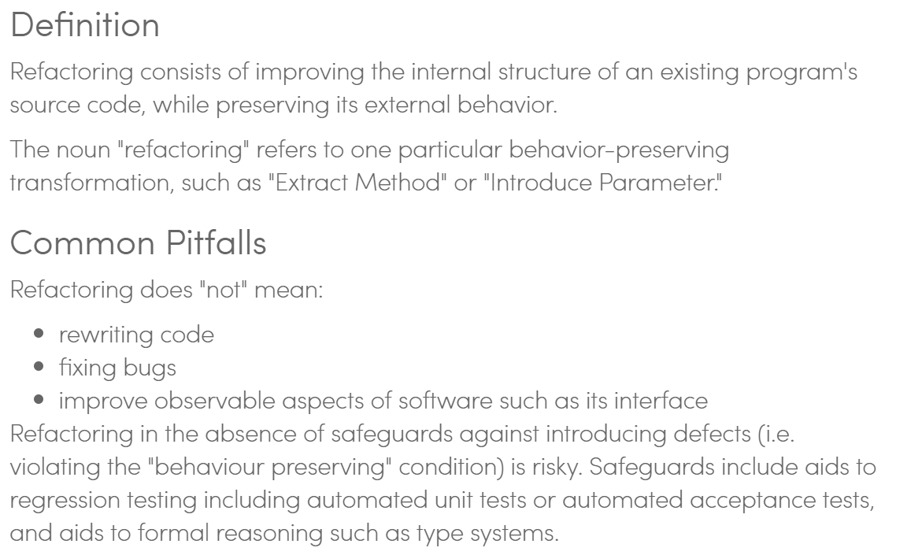
Code Refactoring in Agile Programming

Slide 4
Assignment
Complete a “pre-release” version of your Mosaic application prior to class on call on Monday. This means that you will be complete with Activities List items 1-3 and part way through item 4.

Slide 6
Assignment Q&A

Slide 7
Assignment
Continue working on your Mosaic application while completing Activities List items through item 7.

Slide 8
Lab
As A Scrum Team:
Coding together on MosaicLite 2.0
Team report out by new Scrum Master at 2:46
Team Report Out Guidelines
Scrum Master will stand up, give your name, your team name, and briefly answer the following questions:
What did you accomplish since the last meeting? And what will you be working on until the next meeting?
Is the team committed to completing assignments? All/Most/Some
What is getting in your way or keeping you from completing the assignments?

Slide 9
End of Session

Slide 10
Technology, Security, & Privacy

Slide 11
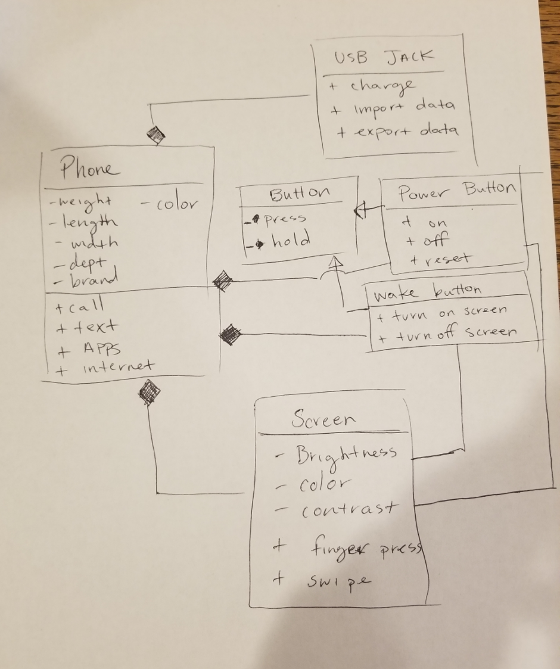
UML Phone Example

Slide 12
Remaining Schedule

